Slide 1
Gencove
Low coverage sequencing with imputation as an alternative traditional methods

Slide 2
Gencove – Theory
Low-coverage sequencing
Imputation of genotypes based on algorithms and a dataset
Questions
Does it call variants accurately across the genome
Is it a cost efficient alternative to standard sequencing of normal samples for tumor/normal analysis?
Can it be used instead of genotyping
Notes:
Alg. Til forudsige race, men har dem ikke io ref panel, evt. regionforskelle
Vis steder hvor jeg har snp og de ikke har etc.
T/N: fcr deep cov som tumor og low cov som normal i mutect2.

Slide 3
Method
6 dogs sequenced (~22X)
4 Flat-coated Retrievers
1 German shepherd
1 Cocker Spaniel
Low-coverage (~1X) fastq files extracted
Uploaded to Gencoves webpage and analyzed

Slide 4
Method
Output
Aligned sequence (BAM/BAI file)
Ancestry (json)
Microbiome
Unmapped sequences to the targeted genome are investigated for ancestry
VCF files

Slide 5
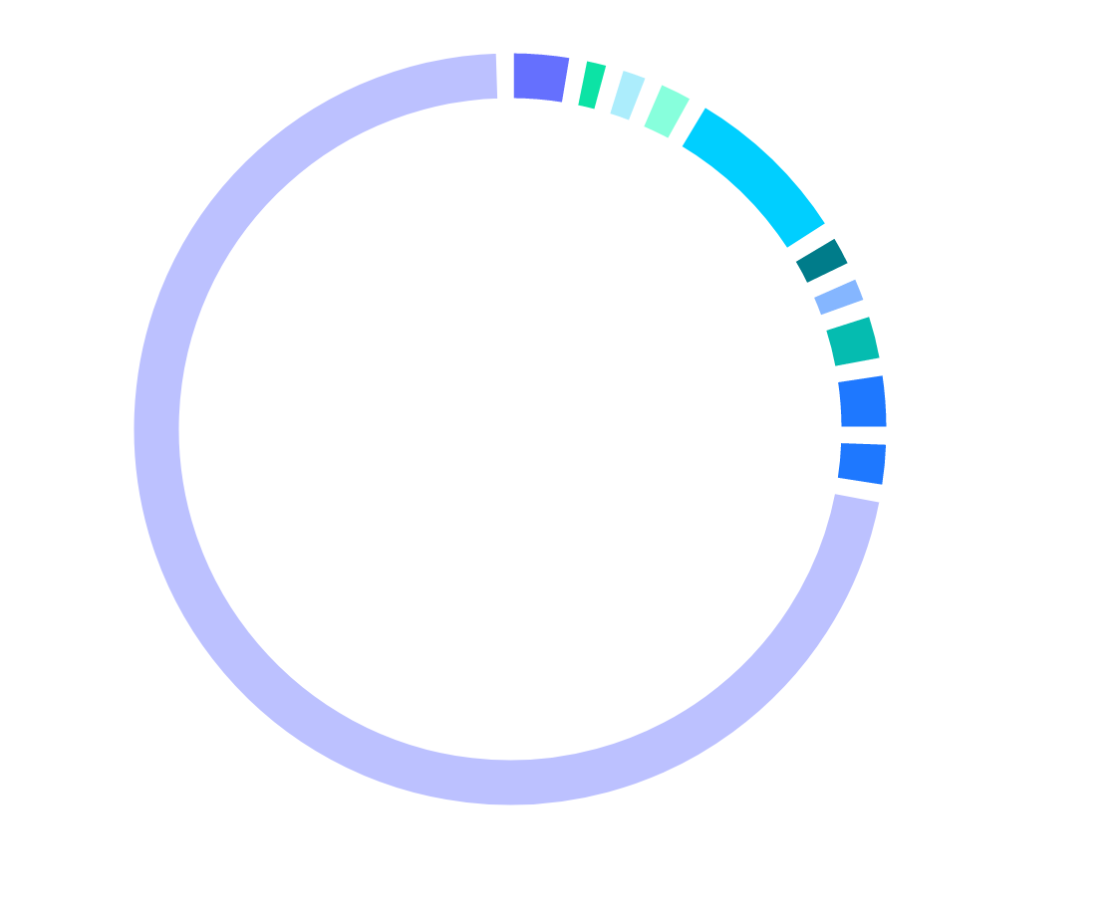
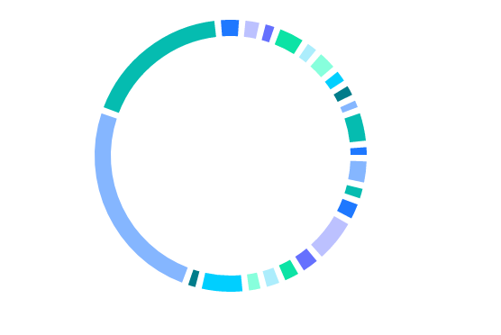





Breed analysis
The Flat-coateds are found to be mixes of primarily Labradors and Golden Retrievers
German Shepherd is 5% Saint Bernhard
Cocker Spaniel is 76% English Cocker Spaniel and 8% Cocker Spaniel
Ancestry of Flat-coated Retriever
German Shepherd

Slide 6
Genotype Calling - Filters
High coverage
QD < 2.0
FS > 60.0
SOR > 3.0
MQ < 40.0
MQRankSum < -12.5
ReadPosRankSum < -8.0
MAF 0.00001
Low coverage
GP > 0.9
Or
GP > 0.7

Slide 7
Genotyping – Summary of Results – GP 0.9
No difference between breeds
All positions and all variants
378530 wrong variants
~6 %
1848160 missed variants
~29 %
All positions and only SNPs
47063 wrong calls
~1 %
11941456 missed calls
~26 %
174k positions (only SNPs)
183 wrong calls
0.003%
3735 missed calls
~4%

Slide 8
Genotyping – Summary of Results – GP 0.7
No difference between breeds
All positions and all variants
486698 wrong variants
~8 %
1726881 missed variants
~27%
All positions and only SNPs
62065 wrong calls
~1 %
1158178 missed calls
~25 %
174k positions (only SNPs)
233 wrong calls
0.3 %
3092 missed calls
~4 %

Slide 9
Comparison
If lowering min(GP) from 0.9 to 0.7
All positions and all variants
Wrong variants:
6 % -> 8 %
Missed variants:
29 % -> 27 %
All positions and only SNPs
Wrong calls
1 % -> 1 %
Missed calls
26 % -> 25 %
174k positions and only SNPs
Wrong calls
0.2 % -> 0.3 %
Missed calls
5 % -> 4 %

Slide 10
Comparisons – All variants – GP 0.9

Slide 11
Comparisons – All variants – GP 0.7

Slide 12
Comparisons – SNPs only – GP 0.9

Slide 13
Comparisons – SNPs only – GP 0.7

Slide 14
Conclusions
Very low %-percentage are called wrong
Still around 200 wrong calls
Will it change results of analysis?
Lowering min(GP) lead to more mistakes but also less missed variants
Suitable for genotyping?
Not sufficiently precise for tumor-normal data

